Slide 1
Stanley Forman
“For his sequence of photographs of a fire in Boston on July 22, 1975”

Slide 2
A firefighter was doing a routine evaluation. He planned on climbing onto the ladder where the grandmother could hand him the baby. After the baby was safe, he could help her onto the ladder so they could all descend.

Slide 3
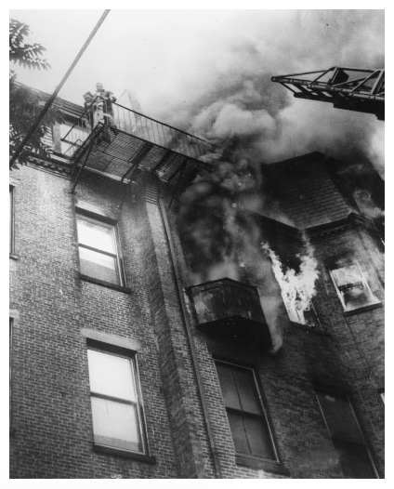
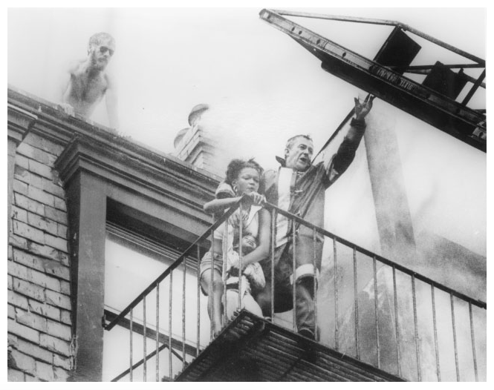

Slide 4
“And then the fire escape let go.”

Slide 5
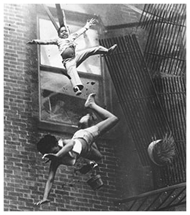
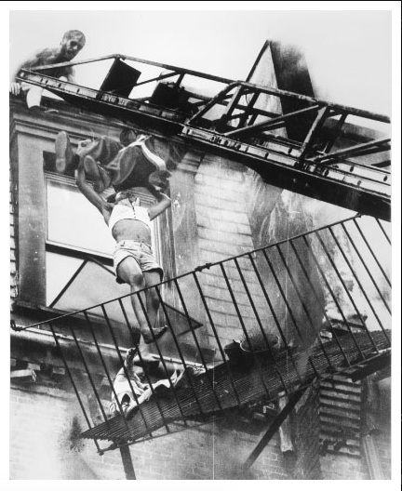

Slide 6
The grandmother and child both fell to the ground, whereas the fireman remained dangling from the ladder until he was able to pull himself up. The firefighter only had one thought…

Slide 7
“Two more seconds and I would have had them, two more seconds.”

Slide 8
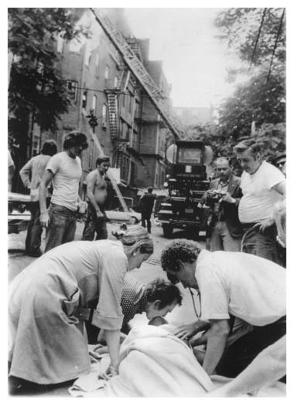

Slide 9
The baby survived, but the grandmother did not.

Slide 10
http://www.pulitzer.org/article/and-then-fire-escape-let-go

Slide 11
Steve Starr
“For his news photo taken at Cornell University, ‘Campus Guns’"

Slide 12
It was Parents’ Weekend at Cornell University, April 18 and 19, 1969. Fire Alarms rang throughout the night. In the morning, fights erupted between the white Delta Upsilon fraternity brothers and the Afro-American Society.

Slide 13
Members of the AAS went to Willard Straight Hall to protest the slow development of a black studies program and allegations of racism. The students left the building Sunday with guns in hand.

Slide 14
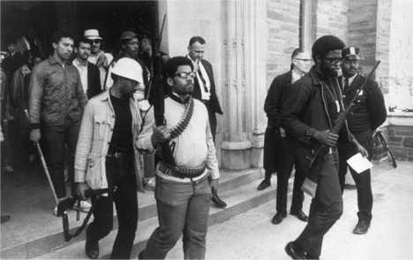

Slide 15
http://news.cornell.edu/stories/2009/04/campus-takeover-symbolized-era-change

